Slide 1
Unit II Electro Analytical Techniques Topic: Conductometric titrations
Dr. P. G. Umape
Pune Institute of Computer Technology

Slide 2
Introduction
Conductometry is a method of analysis based on measuring the conductivity of ionic solutions caused by the mobility of ions toward respective electrodes in the presence of an electric field.
Conductivity is measured by using a conductometer (or conductivity probe).
Conductometric titration: The determination of an end point or equivalence point of a titration by means of conductivity measurements is know as conductometric titration. Here the conductivity depends upon number and mobility of ions present in electrolytic solutions.

Slide 3
Conductometric titrations
Following are the different conductometric titrations
Acid-base titration
Precipitation titration
Replacement titration
Redox (oxidation-reduction) titration
Complexometric titration

Slide 4
Conductometric titrations
Factors affecting conductivity of an electrolytic solution
Number of ions per ml: Greater the number of ions per ml in the solution, higher will be the specific conductance. At higher concentration number of ions per ml is higher.
Concentration: at higher concentration the number of ions available for conductance is less due to low dissociation. Hence specific conductance is slightly lesser than expected. In other words, decrease in concentration leads to increased equivalence conductance although specific conductance lowers. It is due to increased number of ions.

Slide 5
Conductometric titrations
Factors affecting conductivity of an electrolytic solution
Mobility of ions: Small size ions have high mobility and high conducting ability.
Charge on ion: Higher the charge on an ion greater is the conducting ability
Temperature: At higher temperature kinetic energy of ions is more, viscosity of water is lesser and ionic interactions are less hence high conductivity.

Slide 6
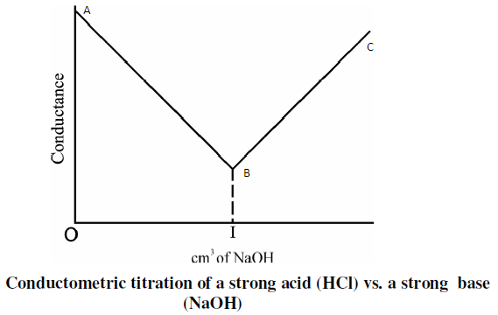
Strong Acid-Strong Base Titration
Consider titration of HCl with NaOH
H⁺+ Cl⁻ + Na⁺ + ⁻OH Na⁺ + Cl⁻ + H₂O

Slide 7
Strong Acid-Strong Base Titration
Strong acid VS Strong Base Titration
(HCl with NaOH)
In this titration HCl is taken in conical flask and burette is filled with standard NaOH solution.
Initially the conductance is high due to the presence of highly mobile hydrogen ions.
When the base is added, the conductance falls due to the replacement of high mobile hydrogen ions by the added low mobile cation (Na⁺).

Slide 8
Strong Acid-Strong Base Titration
Strong acid VS Strong Base Titration
As H+ ions react with OH⁻ ions to form water molecule. This decrease in the conductance.
This decrease in the conductance continues till the equivalence point.
At the equivalence point, the solution contains only NaCl.
After the equivalence point excess NaOH is added and hence the conductance increases.
It is due to the large conductivity of OH- ions.

Slide 9
Strong Acid-Strong Base Titration
Strong acid VS Strong Base Titration
In the figure AB curve indicates decrease in conductance due to addition of NaOH, point B indicates equivalence point.
while Curve BC indicates increase in conductance due to addition of excess NaOH after neutralization.
Hence by knowing equivalence point strength of acid/base can be calculated by using formula,
N₁V₁ = N₂V₂

Slide 10
Thank you

